Slide 1
A Stroking Analysis of Strokes
Hunter Blum
Ben Earnest
Andrew Pak Kim

Slide 2
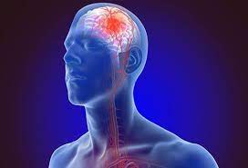
Background
Second leading cause of death and disability in the world.
Massive costs in the U.S.A. alone.
Early prevention has been successful.
Identify the most accurate and sensitive modelling algorithm.
Wedro (2021)

Slide 3
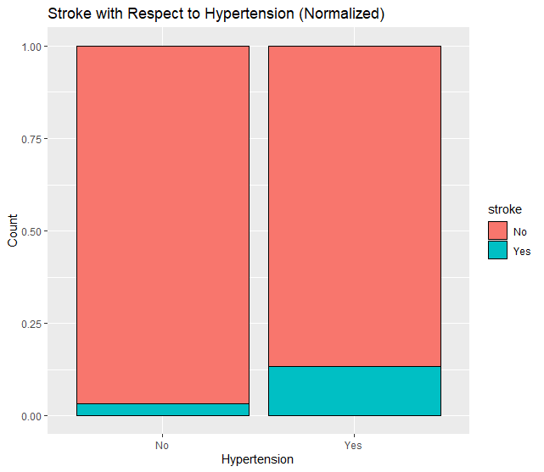
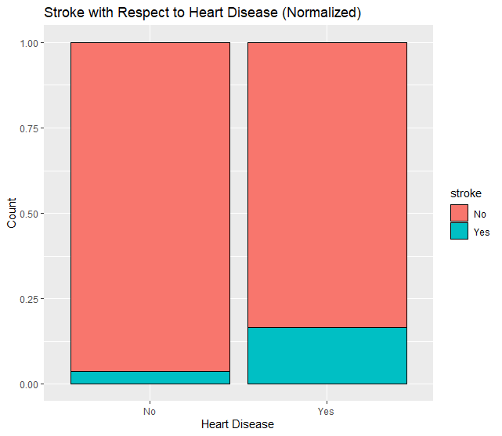
Exploratory Data Analysis

Slide 4
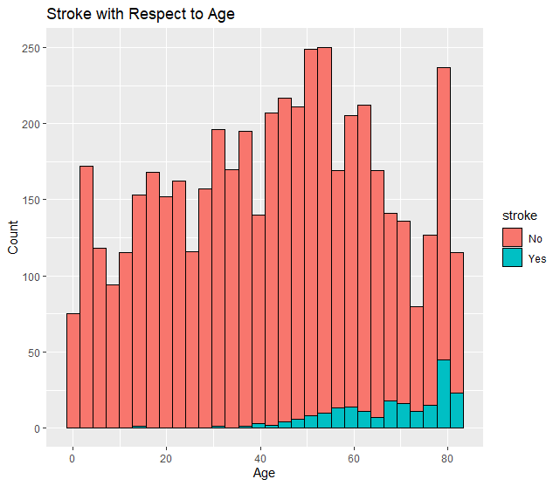
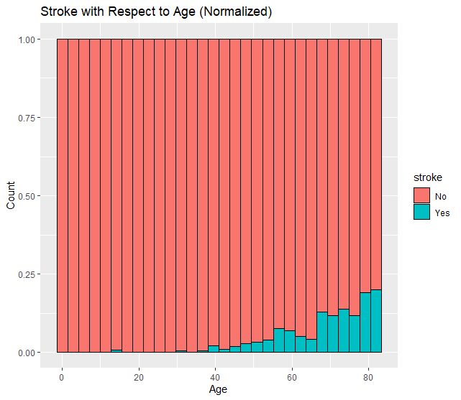
Exploratory Data Analysis

Slide 5
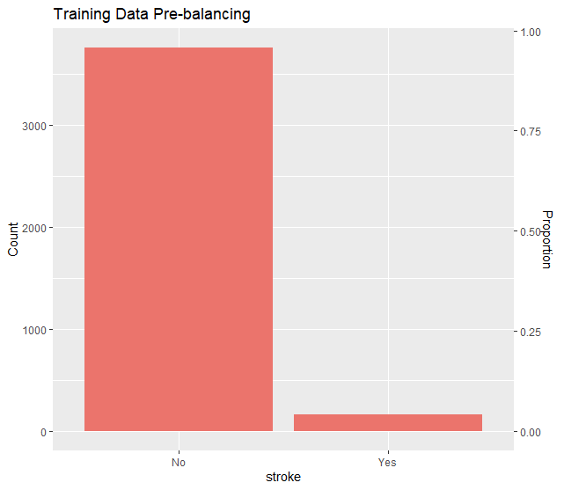
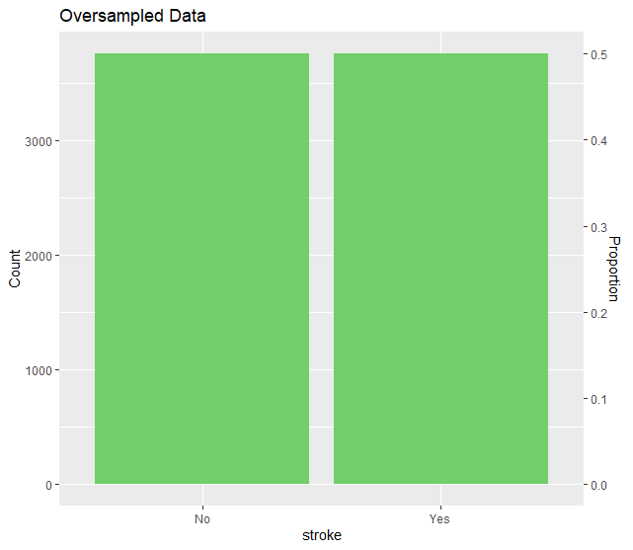
Model Prep – Balancing Classes

Slide 6
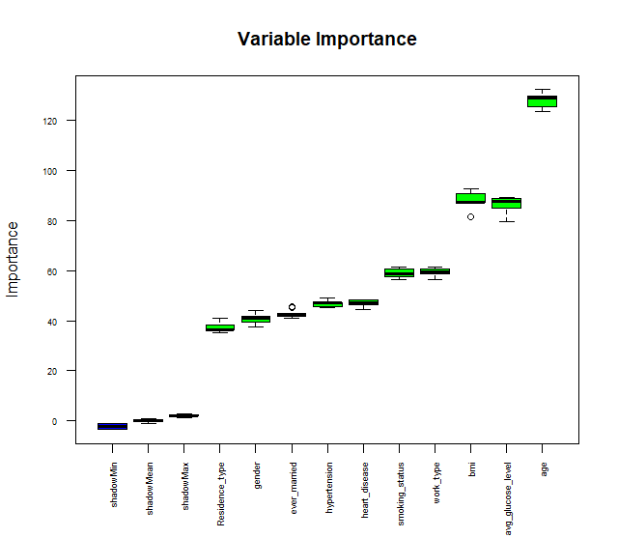
Model Prep – Feature Selection

Slide 7
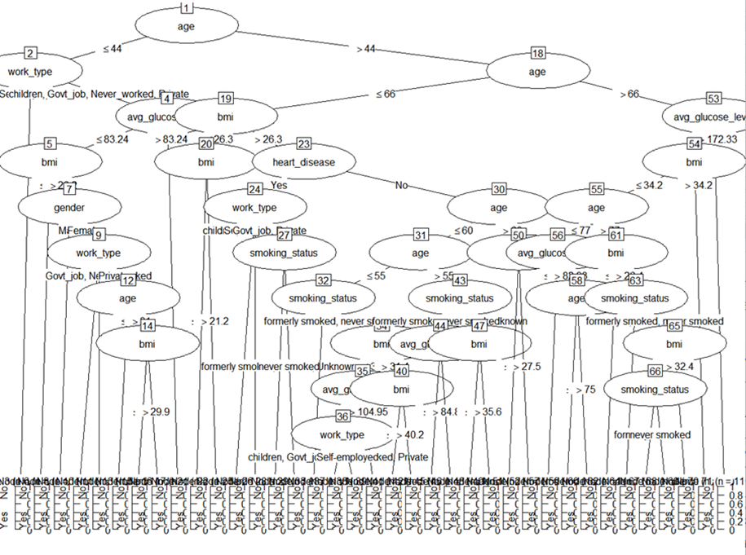
C5.0
Age serves as the root node
66 nodes
78% accuracy
54% sensitivity
80% specificity

Slide 8
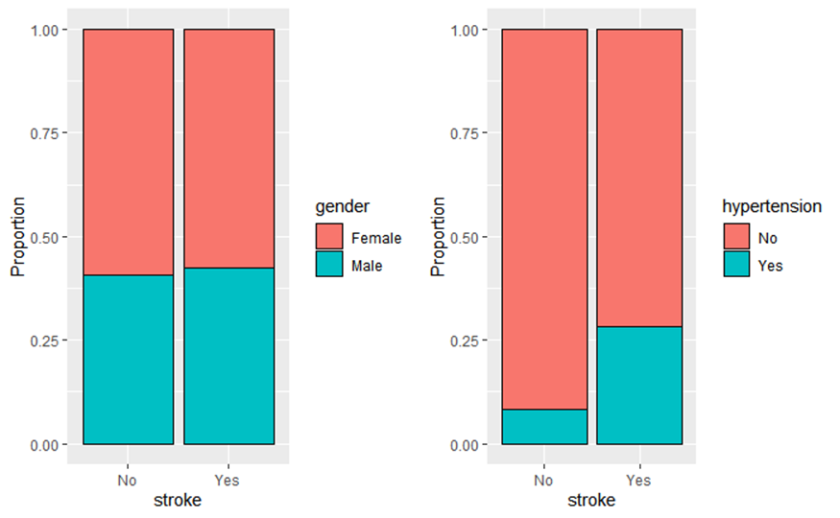
Naïve Bayes Pt. 1
The NB model of “stroke” in association with “gender” and “hypertension” generated the highest accuracy rating of 88% and the highest specificity rating of 91%.

Slide 9
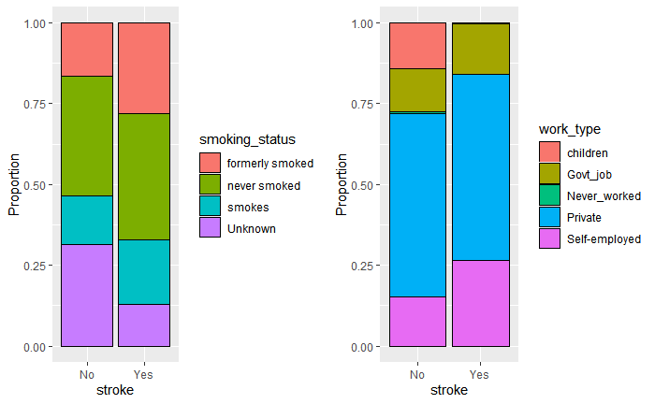
Naïve Bayes Pt. 2
The NB model that evaluated “stroke” in association with “smoking status” and “work type” generated the lowest accuracy percentage rating of approximately 33%.

Slide 10


CART
Age is root node (similar to C5.0)
9 leaf nodes in total
Accuracy is 80%
Sensitivity is 89%
Specificity is 70%

Slide 11
Cost Sensitive CART
 | Actual: No | Actual: Yes
Predicted: No | 466 | 1
Predicted: Yes | 473 | 40
Assumed false negative 10x costly as false positive
Used balanced data set to train model
Accuracy is 52%
Sensitivity is 96%
Specificity is 50%

Slide 12
Logistic Regression
Predicted all positive model (stroke = Yes)
Used balanced, standardized data set
Removed predictor variables with p < 0.05
Parametric model:
 | Actual: No | Actual: Yes
Predicted: No | 0 | 0
Predicted: Yes | 939 | 41

Slide 13
Random Forest
 | Actual: No | Actual: Yes
Predicted: No | 939 | 41
Predicted: Yes | 0 | 0
All-negative model
95.8% Accuracy

Slide 14
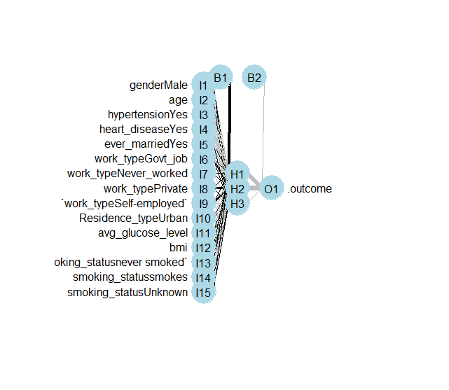
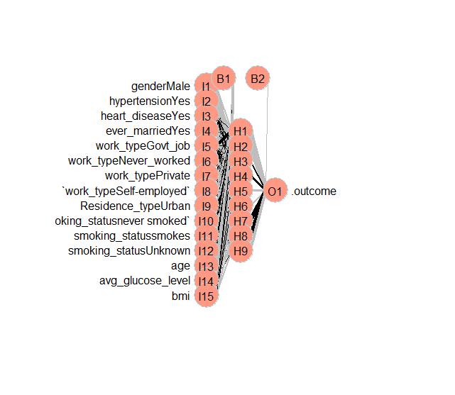
Neural Network

Slide 15
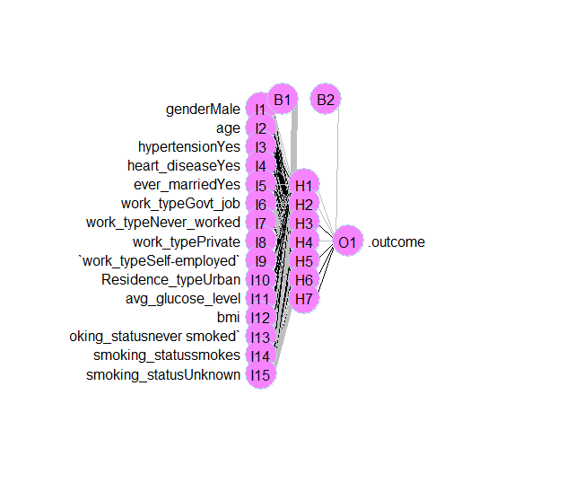
Neural Network
 | Actual: No | Actual: Yes
Predicted: No | 692 | 4
Predicted: Yes | 247 | 37
74.4% accuracy
90.2% sensitivity

Slide 16
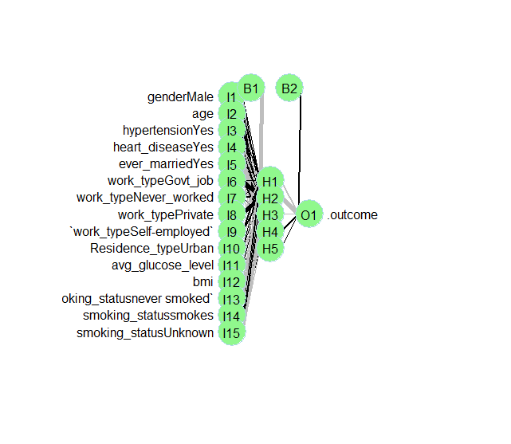
Neural Network
 | Actual: No | Actual: Yes
Predicted: No | 695 | 5
Predicted: Yes | 244 | 36
74.6% accuracy
87.8% sensitivity

Slide 17
Results Pt. 1
Model | Accuracy | Sensitivity | Specificity | Precision | F1
Baseline | 0.958 | 0.000 | 1.000 | 0.000 | 0.000
Log Reg. | 0.042 | 1.000 | 0.000 | 0.418 | 0.080
ANN Reg. | 0.958 | 0.000 | 1.000 | 0.000 | 0.000
ANN Bal. | 0.744 | 0.902 | 0.737 | 0.130 | 0.228
ANN Z | 0.958 | 0.000 | 1.000 | 0.000 | 0.000
ANN Z Bal. | 0.613 | 0.878 | 0.602 | 0.088 | 0.160
RF Reg. | 0.958 | 0.000 | 1.000 | 0.000 | 0.000
RF Bal. | 0.948 | 0.000 | 0.989 | 0.000 | 0.000
CART Bal. | 0.700 | 0.902 | 0.691 | 0.113 | 0.201
CART Cost | 0.845 | 0.512 | 0.860 | 0.138 | 0.218
CART Cost Bal. | 0.516 | 0.976 | 0.496 | 0.078 | 0.144
C5.0 Bal. | 0.785 | 0.537 | 0.796 | 0.103 | 0.173
NB Gender | 0.885 | 0.268 | 0.912 | 0.117 | 0.163
NB Heart + Marry | 0.376 | 0.878 | 0.354 | 0.056 | 0.105
NB Resident | 0.505 | 0.512 | 0.505 | 0.0432 | 0.080

Slide 18
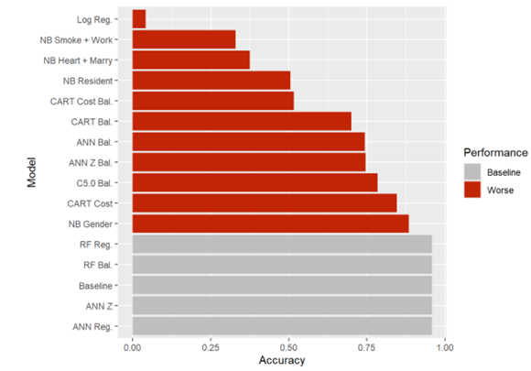
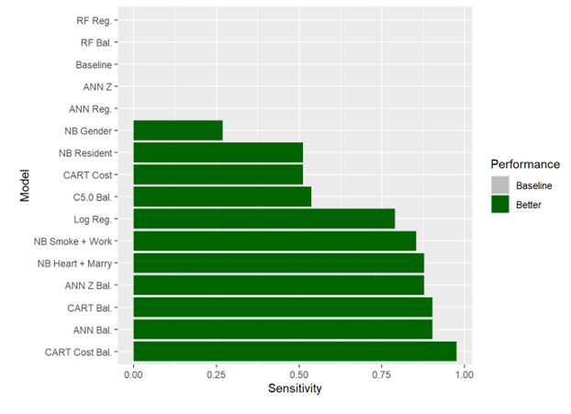
Results Pt. 2

Slide 19
Conclusion
Balanced, cost-sensitive CART (CART Cost Bal.) model
Balanced artificial neural network (ANN Bal.) model.

Slide 20
References
Benjamin Wedro, M. D. (2021, November 12). Stroke: Fast, symptoms, causes, types, treatment, prevention. MedicineNet. Retrieved April 17, 2022, from https://www.medicinenet.com/stroke_symptoms_and_treatment/article.htm
Centers for Disease Control and Prevention. (2022, April 5). Stroke facts. Centers for Disease Control and Prevention. Retrieved April 13, 2022, from https://www.cdc.gov/stroke/facts.htm
Emon, M. U., Keya, M. S., Meghla, T. I., Rahman, M. M., Al Mamun, M. S., & Kaiser, M. S. (2020, November). Performance analysis of machine learning approaches in stroke prediction. In 2020 4th International Conference on Electronics, Communication and Aerospace Technology (ICECA) (pp. 1464-1469). IEEE.
Markus, H. (2008). Stroke: causes and clinical features. Medicine. 36(11). Elsevier Ltd.
Murphy, S. J., & Werring, D. J. (2020). Stroke: causes and clinical features. Medicine, 48(9), 561-566.
Palacios, F. S. (2021, January 26). Stroke prediction dataset. Kaggle. Retrieved April 14, 2022, from https://www.kaggle.com/datasets/fedesoriano/stroke-prediction-dataset
Pandian, J. D., Gall, S. L., Kate, M. P., Silva, G. S., Akinyemi, R. O., Ovbiagele, B. I., ... & Thrift, A. G. (2018). Prevention of stroke: a global perspective. The Lancet, 392(10154), 1269-1278.
R Core Team (2021). R: A language and environment for statistical computing. R Foundation for Statistical Computing, Vienna, Austria. URL https://www.R-project.org/.
Singh, M. S., & Choudhary, P. (2017, August). Stroke prediction using artificial intelligence. In 2017 8th Annual Industrial Automation and Electromechanical Engineering Conference (IEMECON) (pp. 158-161). IEEE.

